Slide 1



“Wasabi”
Analysis...
...and Binary Instrumentation
Work in
Progress

Slide 2
Overview
Why?
How?
What for?

Slide 3
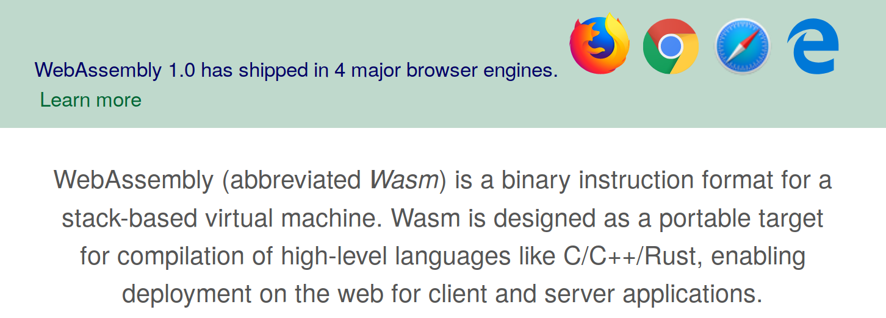
WebAssembly in a Nutshell
webassembly.org
Minimum Viable Product (MVP) is complete
Binary format: compact, fast to decode
Compilation target for “systems” languages

Slide 4
WebAssembly MVP
What it cannot do (right now)
  GC, easy interop with JavaScript objects, DOM
  ES module integration: <script type=”wasm” src=...>
  Multithreading, shared memory, SIMD, exceptions, …
How it can be used from JavaScript:
let bytes = fetch(“add.wasm”);
let imports = {
print: function(i32) { console.log(i32); }
}
let module = WebAssembly.instantiate(bytes, imports);
module.exports.addAndPrint(1, 2); // prints “3”

Slide 5


WebAssembly ↔ JavaScript Interop
let typedArray = new
Uint32Array(wasmMemory);
typedArray[0] = object.a;
typedArray[1] = object.b;
...
Passing data between
Wasm ↔ JavaScript
  Function arguments
  Imported globals
  Imported memory
4 types in Wasm: i32 i64 f32 f64
  i32 and f32 can be represented without loss as
  JavaScript number (f64)
  i64 cannot be passed to/from JavaScript
i32.const 1 // address
i32.load
// stack top == object.b

Slide 6
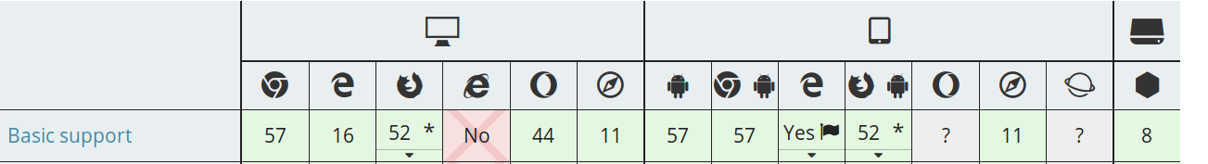

Slide 7
WebAssembly Example
(module
(import "print" (func $0 (param i32) (result)))
(func $1 (param i32 i32) (result)
get_local 0
get_local 1
i32.add
call $0)
(export "addAndPrint" (func $1))
)
add.wat
wat2wasm
wat2
wasm
6100 6d73 0001 0000 0a01 6002 7f01 6000
7f02 007f 1102 0701 6d69 6f70 7472 0573
7270 6e69 0074 0300 0102 0701 010f 610b
6464 6e41 5064 6972 746e 0100 0b0a 0901
2000 2000 6a01 0010 000b
emcc
rustc
add.wasm

Slide 8
WebAssembly Use Cases
Use cases
  In general: any number crunching
  More idealized: “decentralized standardization”
  Machine learning, computer vision (e.g. bar code scanner, face detection)
  Games, simulation: http://webassembly.org/demo/Tanks/
  Codecs, media players, → NASA WebVR demo
  Google Maps
  threejs 3D object compression

Slide 9
Binary Instrumentation
Foundation for many dynamic analyses
  Coverage, profiling (memory & time)
  Taint analysis, symbolic execution
  Record-replay, memory/function/instruction tracing
Related work
  Jalangi, Sen et al., FSE 2013
  Pin, Luk et al., PLDI 2005
  Valgrind, Nethercote & Seward, PLDI 2007
  DynamoRIO, RoadRunner, ASM, ...
JavaScript
x86(-64)

